Slide 1
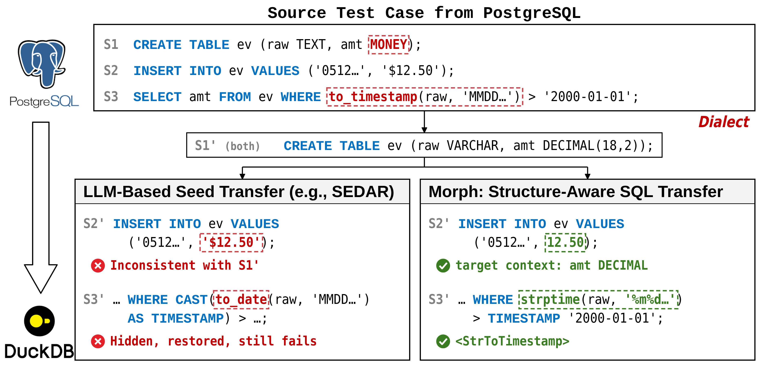

Slide 2
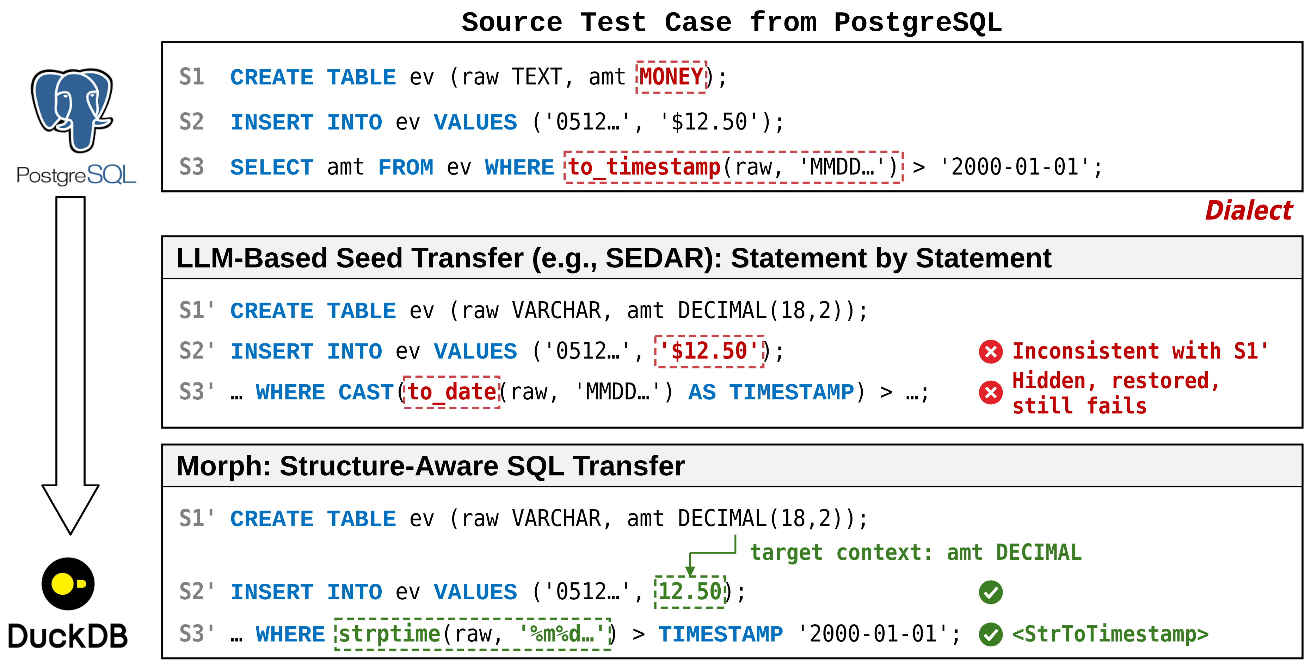

Slide 3
Morph

Slide 4




Source Seed From PostgreSQL
Source Seed from PostgreSQL: SELECT * FROM t0 WHERE AGE(t0.c1, NOW()) > '1 year'::INTERVAL;
Dialect
Conventional End-to-End Translation Methods
Morph: Structure-Aware SQL Transfer
Step1: LLM Translation
Step 1: Query Logic Abstraction
Semantic Deviation
Constraint Reasoning
WHERE AGE(t0.c1, ...) > ...
WHERE <TimeDiff> > <Interval>
Step2: Unparsable Commenting
Step 2: Dialect-Aware AQT Instantiation
Logic Loss
Logic Preserved
WHERE /*AGE...*/ TRUE
WHERE date_diff('year') > INTERVAL ...;

Slide 5
Source Seed From PostgreSQL
修改的图
SELECT * FROM t0 WHERE AGE(t0.c1, NOW()) > '1 year'::INTERVAL;
Dialect
Conventional Translation Methods
Morph: Structure-Aware SQL Transfer
Step1: LLM Translation
Step 1: Query Logic Abstraction
Semantic Deviation
Constraint Reasoning
WHERE AGE(t0.c1, ...) > ...
WHERE <TimeDiff> > <Interval>
Step2: Unparsable Commenting
Step 2: Dialect-Aware AQT Instantiation
Logic Loss
Logic Preserved
WHERE /*AGE...*/ TRUE
WHERE date_diff('year') > INTERVAL ...;

Slide 6
Source Seed From PostgreSQL
SELECT * FROM t0 WHERE AGE(t0.c1, NOW()) > '1 year'::INTERVAL;
Dialect
LLM-Based Seed Transfer (e.g.,SEDAR)
Morph: Structure-Aware SQL Transfer
Step1: LLM Translation
Step 1: Query Logic Abstraction
Semantic Error
Constraint Reasoning
WHERE AGE(t0.c1, ...) > ...
WHERE <TimeDiff> > <Interval>
Step2: Commenting and Restoration
Step 2: Dialect-Aware AQT Instantiation
/*AGE...*/ TRUE
Translation
Error Persists
Structure Preserved
WHERE AGE(t0.c1, ...) > ...
WHERE date_diff('year') > INTERVAL ...;

Slide 7










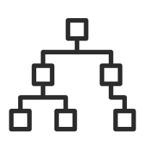


Structure-Preserving Abstraction
Dialect-Aware AQT Instantiation
Feedback-Driven Adaptive Fuzzing
Skill Execution
AQT
Generator
SQL Translator
Query Sanitizer
Schema
Task
Planner
Error Fixer
SQL Parser
AQTs
Error
Msg
Fixed
Seed
Test
Cases
Rule Generator
Translated Seeds
Query
Token
Bugs
Mutable
Seeds
Dialect
Reduce
Knowledge
Base
Top-k
Dialect
Error Fixer
AST
Fuzzer

Slide 8
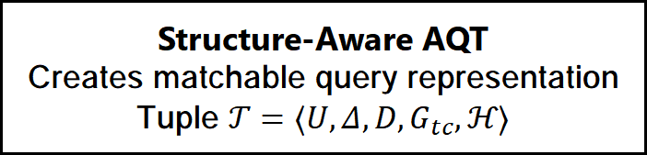
Source AST
Abstraction Engine
Structure-
Aware AQT
SELECT
SELECT
WHERE
Rules R
AGE(·) → <TimeDiff>
::INT → <TypeCast>
MIN(·) → <AggMin>
WHERE
Input
Extract
＞
＞
SUBQUERY
ROOT
u.created_at
SUBQUERY
u.created_at
SELECT
ID:1 → [..., <Ptr:2>]
ID:2 → [<AggMin>, ...]
Discarded:
AGE(), ::INT
AGE(...)
FROM
Boundary Detection
  Identifies query boundaries
  Detects nested SELECT, CTE patterns
Normalizes Dialect
Applies rules R
(e.g., AGE→<TimeDiff>)
Structure-Aware AQT
Creates matchable query representation Tuple $𝒯=⟨U,Δ,D,G_{tc},ℋ⟩$

Slide 9
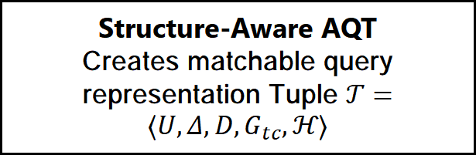
Source AST
Abstraction Engine
Structure-
Aware AQT
SELECT
SELECT
修改的图
WHERE
Rules R
AGE(·) → <TimeDiff>
::INT → <TypeCast>
MIN(·) → <AggMin>
WHERE
＞
Input
Extract
＞
SUBQUERY
ROOT
u.created_at
SUBQUERY
u.created_at
SELECT
ID:1 → [..., <Ptr:2>]
ID:2 → [<AggMin>, ...]
Discarded:
AGE(), ::INT
AGE(...)
FROM
Normalizes Dialect
Applies rules R
(e.g., AGE→<TimeDiff>)
Structure-Aware AQT
Creates matchable query representation Tuple $𝒯=⟨U,Δ,D,G_{tc},ℋ⟩$
Boundary Detection
Identifies query boundaries
Detects nested SELECT, CTE patterns

Slide 10





Input Context
Task Planner
Test-Oriented Skill Execution
(LLM empowerment)
Compatible Seeds
AQT
SELECT
Order:
ID2→ID1
ID2→ID3
ID1→ID3
SELECT * FROM users u
WHERE u.created_at > (
SELECT MIN(ts)
FROM logs WHERE CAST(
date_sub('year', ts,
current_date) AS INT)
>= 1);
1
SQL Translator
(Index-Guided Fusion)
WHERE
3
ID:3
>
2
Rule Generator
(Zero-shot Reasoning)
SUBQUERY
u.created_at
Bottom-up Sort
ID:1 → [..., <Ptr:2>]
ID:2 → [<AggMin>, ...]
Error Fixer
(Iterative Repair)
1. Dialect Aligned
2. Execution Validity
1
Order:
ID2→ID1
ID1→ID3
Sseg
3
SELECT * FROM users u WHERE u.created_at > (SELECT MIN(ts)
FROM logs WHERE EXTRACT(YEAR
FROM AGE(ts))::INT >= 1);
Hybrid KB
2
Verification
Vector
Index
Pattern
Store

Slide 11
Source Seed: SELECT * FROM t0 WHERE AGE(t0.c1, NOW()) > '1 year'::INTERVAL;
Sedar
Hallucinations
Ours: Morph
Step1: LLM Translation
Step1: Abstraction (AQT)
WHERE AGE(t0.c1, ...) > ...
WHERE <TimeDiff> > <Interval>
Step2: Unparsable Commenting
Step2: Instantiation (DuckDB)
WHERE date_diff('year') > INTERVAL ...;
Logic Preserved
WHERE /*AGE...*/ TRUE
Result: Logic Degraded
Result: High-Fidelity Seed
Logic Loss
Logic Preserved
Logic Loss

Slide 12
Sedar
Step1: LLM Translation
Result: Logic Degraded
Sedar
WHERE AGE(t0.c1, ...) > ...
Source Seed (PostgreSQL)
Logic Loss
Source Seed: SELECT * FROM t0 WHERE AGE(t0.c1, NOW()) > '1 year'::INTERVAL;
Step2: Unparsable Commenting
WHERE /*AGE...*/ TRUE
Result: Logic Degraded
Step1: LLM Translation
Step2: Unparsable Commenting
WHERE AGE(t0.c1, ...) > ...
WHERE /*AGE...*/ TRUE
Hallucinations
Logic Loss
Ours: Morph
Step1: Abstraction (AQT)
WHERE <TimeDiff> > <Interval>
Step1: Query Abstraction (AQT)
Step2: Instantiation (DuckDB)
Logic Preserved
WHERE <TimeDiff> > <Interval>
WHERE date_diff('year') > INTERVAL ...;
Step2: Instantiation (DuckDB)
Translate Success
Logic Preserved
WHERE date_diff('year') > INTERVAL ...;
Result: High-Fidelity Seed

Slide 13
Source Seed: SELECT * FROM t0 WHERE AGE(t0.c1, NOW()) > '1 year'::INTERVAL;
Sedar
Step1: LLM Translation
Step2: Unparsable Commenting
WHERE AGE(t0.c1, ...) > ...
WHERE /*AGE...*/ TRUE
Hallucinations
Logic Loss
Morph
Step1: Query Abstraction (AQT)
Step2: Instantiation
WHERE <TimeDiff> > <Interval>
WHERE date_diff('year') > INTERVAL ...;
Translate Success
Logic Preserved

Slide 14




Syntax-Aware Query Abstraction
Rule-Guided Recursive Dialect Instantiation
Feedback-Driven Adaptive Fuzzing
Skill Executor
AQT
Generator
SQL Translator
Query Sanitizer
SQL Parser
Schema
Task
Planner
Error Fixer
AQTs
Error
Msg
Fixed
Seed
Test
Cases
Rule Generator
Translated Seeds
Bugs
Mutable
Seeds
Error Fixer
Dialect
Reduce
Knowledge
Base
AST
Fuzzer

Slide 15
Error
Msg
Fixed
Seed
AST Segmentation
Dialect-Specific Reduce
Mutable Seeds
Syntax-Aware Query Abstraction
Rule-Guided Recursive Dialect Instantiation
Feedback-Driven Adaptive Fuzzing
Skill Executor
Mutable
Seeds
Task Planner
SQL Translator
SQL Parser
Schema
AQTs
Translated Seeds
Error Fixer
Schema
Rule Generator
Test Cases
Error
Msg
Bugs
Dialect
Reduce
Knowledge Base
Error Fixer
Fuzzer Parser
Query Sanitizer
AST

Slide 16
Error
Msg
Fixed
Seed
AST Segmentation
Dialect-Specific Reduce
Mutable Seeds
Syntax-Aware Query Abstraction
Rule-Guided Recursive Dialect Instantiation
Feedback-Driven Adaptive Fuzzing
Skill Executor
Mutable
Seeds
Task Planner
SQL Translator
SQL Parser
Schema
AQTs
Translated Seeds
Error Fixer
Schema
Rule Generator
Test Cases
Error
Msg
Bugs
Dialect
Reduce
Knowledge Base
Error Fixer
Query Sanitizer
AST
Fuzzer

Slide 17

Syntax-Aware Query Abstraction
Rule-Guided Recursive Dialect Instantiation
Feedback-Driven Adaptive Fuzzing
Dialect-Specific Reduce
Skill Executor
Adaptive Query Sanitizer
AST Segmentation
Error-Guided Repair
Task Planner
SQL Translator
AQTs
Translated Seeds
Schema
Rule Generator
Test Cases
Static Analysis Engine
Bugs
Mutable
Seeds
DBMS
Fuzzers
Knowledge Base
Error Fixer
AST
Schema

Slide 18

Task Planner
Syntax-Aware Query Abstraction
Rule-Guided Recursive Dialect Instantiation
Feedback-Driven Adaptive Fuzzing
AST Segmentation
Dialect-Specific Reduce
Adaptive Query Sanitizer
Error-Guided Repair
AQTs
Translated Seeds
Task Planner
Knowledge Base
Test Cases
Static Analysis Engine
Skill Executor
Bugs
AST
Schema
SQL
Translator
Rule Generator
Error
Fixer
Mutable
Seeds
DBMS
Fuzzers
SQL
Translator
Rule
Generator

Slide 19

Task Planner
Syntax-Aware Query Abstraction
Rule-Guided Recursive Dialect Instantiation
Feedback-Driven Adaptive Fuzzing
AST Segmentation
Dialect-Specific Reduce
Hybrid Knowledge Base
Adaptive Query Sanitizer
Error-Guided Repair
Abstract Pattern Store
Vector Index
AQTs
Translated Seeds
Test Cases
Static Analysis Engine
LLM Dynamic Skill Executor
Bugs
AST
Schema
SQL
Translator
Error
Fixer
Mutable
Seeds
DBMS
Fuzzers
Rule
Generator

Slide 20
Task Planner
Hybrid Knowledge Base
Abstract Pattern Store
Vector Index
Rule Generator
Error Fixer
Syntax-Aware Query Abstraction
Rule-Guided Recursive Dialect Instantiation
Feedback-Driven Adaptive Fuzzing
LLM Dynamic Skill Executor
AST Segmentation
Dialect-Specific Reduce
Adaptive Query Sanitizer
Error-Guided Repair
AQTs
Translated Seeds
Translator
Test Cases
Static Analysis Engine
Bugs
AST
Schema
Mutable
Seeds
DBMS
Fuzzers
Generator

Slide 21
Syntax-Aware Query Abstraction
Rule-Guided Recursive Dialect Instantiation
Feedback-Driven Adaptive Fuzzing
AST Segmentation
Dialect-Specific Reduce
Task Planner
Hybrid Knowledge Base
Adaptive Query Sanitizer
Error-Guided Repair
Abstract Pattern Store
Vector Index
AQTs
Translated Seeds
Test Cases
Static Analysis Engine
Bugs
LLM Dynamic Skill Executor
AST
Schema
Mutable
Seeds
DBMS
Fuzzers
SQL
Translator
Rule Generator
Error Fixer

Slide 22
Syntax-Aware Query Abstraction
Rule-Guided Recursive Dialect Instantiation
Feedback-Driven Adaptive Fuzzing
AST Segmentation
Dialect-Specific Reduce
Task Planner
Hybrid Knowledge Base
Adaptive Query Sanitizer
Error-Guided Repair
AQTs
Abstract Pattern Store
Vector Index
Translated Seeds
Test Cases
Static Analysis Engine
Bugs
LLM Dynamic Skill Executor
Mutable Seeds
DBMS Fuzzers
AST
Schema
SQL
Translator
Rule Generator
Error Fixer

Slide 23

Syntax-Aware Query Abstraction
Rule-Guided Dialect Translation
Feedback-Driven Mutation Loop
AST Segmentation
Dialect-Specific Reduce
Task Planner
Hybrid Knowledge Base
Adaptive Query Sanitizer
Mutable Seeds
Statement
Abstract Pattern Store
Vector Index
Static Analysis Engine
Test Cases
Abstract Query Templates
LLM Dynamic Skill Executor
Compatible Seeds
DBMS Fuzzers
BUGS
Abstract Syntax Tree
Schema Information
SQL
Translator
Rule Generator
Error Fixer

Slide 24
Syntax-Aware Query Abstraction
Rule-Guided Recursive Dialect Instantiation
Feedback-Driven Adaptive Fuzzing
AST Segmentation
Dialect-Specific Reduce
Task Planner
Hybrid Knowledge Base
Adaptive Query Sanitizer
Error-Guided Repair
AQT
Abstract Pattern Store
Vector Index
Translated Seeds
Static Analysis Engine
Test Cases
LLM Dynamic Skill Executor
Mutable Seeds
DBMS Fuzzers
BUGS
AST
Schema
SQL
Translator
Rule Generator
Error Fixer

Slide 25
SQL statements in PostgreSQL test cases
The PoC to trigger a crash in DuckDB
CREATE TABLE t2 (c2 DOUBLE PRECISION);
CREATE TABLE t0(c0 INT); CREATE TABLE t1(c0 INT);
CREATE TABLE t2(c2 DOUBLE);
SELECT * FROM t0, t2, t1,
(SELECT DISTINCT t1.c0, t2.c2 FROM t1) as sub0
CROSS JOIN (SELECT t0.c0)
SELECT * FROM t0, t2, t1 CROSS JOIN (
SELECT t1.c0, t2.c2 FROM t1
) as subQuery0;

Slide 26
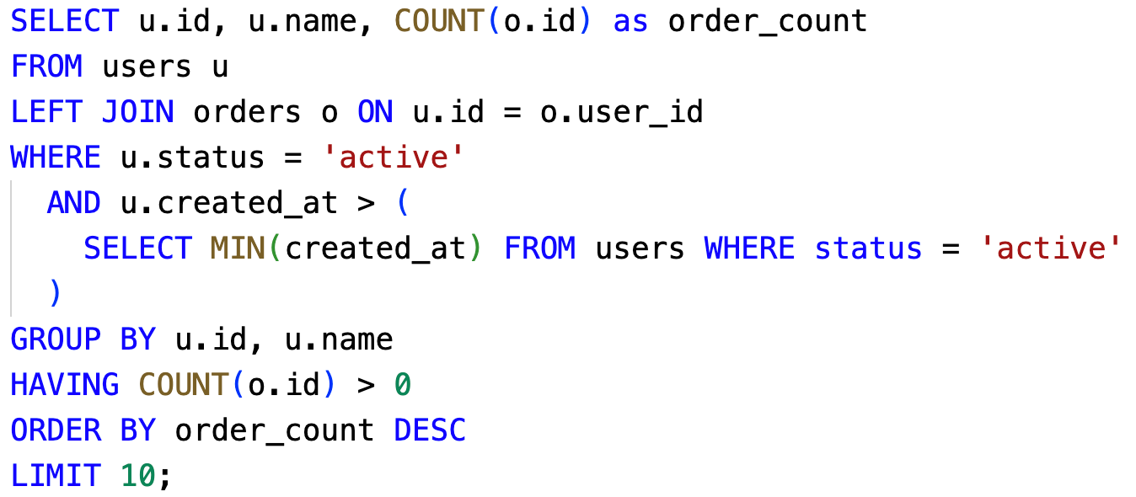
SQL statements
AQT
Segment[0]: normalized_sql
(2382dbbf_s1)
Hash:SHA256
Complexity Score: 21.2
Structure Graph
2382dbbf_s1 (statement)
└──> 2382dbbf_s1_sub_5b34c8 (sub)
Segment[1]:normalized_sql (2382dbbf_s1_sub_5b34c8)
Complexity Score: 7.6

Slide 27
SQLEEk

Slide 28
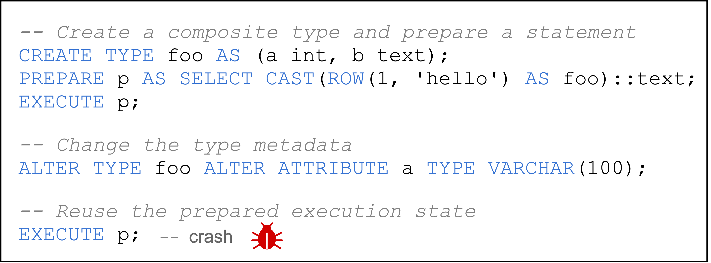

Slide 29
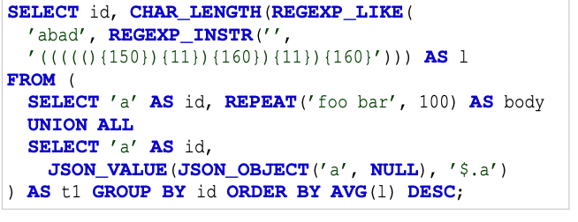

Slide 30
execExprInterp.c ·3441–3448
3441
void
3442
ExecEvalRow(ExprState *state, ExprEvalStep *op)
3443
{
3444
HeapTuple tuple;
3445
/* build tuple from evaluated field values */
3446
tuple = heap_form_tuple(op->d.row.tupdesc,
3447
op->d.row.elemvalues,
3448
op->d.row.elemnulls);
rowtypes.c ·363–368
363
values = (Datum *) palloc(ncolumns * sizeof(Datum));
364
nulls = (bool *) palloc(ncolumns * sizeof(bool));
365
366
/* Break down the tuple into fields */
367
heap_deform_tuple(&tuple, tupdesc, values, nulls);
368
/* And build the result string */
heaptuple.c · 1330–1338
1330
/* not varlena, so safe to use att_nominal_alignby */
1331
off = att_nominal_alignby(off, thisatt->attalignby);
1332
if (!slow)
1333
thisatt->attcacheoff = off;
1334
}
1335
1336
values[attnum] = fetchatt(thisatt, tp + off);
1337
✗ crash
1338
off = att_addlength_pointer(off, thisatt->attlen, tp + off);

Slide 31
rowtypes.c ·363–368
363
values = (Datum *) palloc(ncolumns * sizeof(Datum));
364
nulls = (bool *) palloc(ncolumns * sizeof(bool));
365
366
/* Break down the tuple into fields */
367
heap_deform_tuple(&tuple, tupdesc, values, nulls);
368
/* And build the result string */
heaptuple.c · 1330–1338
1330
/* not varlena, so safe to use att_nominal_alignby */
1331
off = att_nominal_alignby(off, thisatt->attalignby);
1332
if (!slow)
1333
thisatt->attcacheoff = off;
1334
}
1335
1336
values[attnum] = fetchatt(thisatt, tp + off);
1337
✗ crash
1338
off = att_addlength_pointer(off, thisatt->attlen, tp + off);

Slide 32
rowtypes.c ·363–368
363
values = (Datum *) palloc(ncolumns * sizeof(Datum));
364
nulls = (bool *) palloc(ncolumns * sizeof(bool));
365
366
/* Break down the tuple into fields */
risk-region entry
367
heap_deform_tuple(&tuple, tupdesc, values, nulls);
368
/* And build the result string */
heaptuple.c · 1330–1338
1330
risk
pattern
/* not varlena, so safe to use att_nominal_alignby */
1331
off = att_nominal_alignby(off, thisatt->attalignby);
1332
if (!slow)
cached field offset
1333
thisatt->attcacheoff = off;
1334
}
layout-based
field access
1335
1336
values[attnum] = fetchatt(thisatt, tp + off);
1337
1338
✗ crash
off = att_addlength_pointer(off, thisatt->attlen, tp + off);

Slide 33
SQLeek identifies high-risk DBMS functions first, then reconstructs the stateful SQL chain needed to reach them.
Traditional Fuzzer
Source code
SQLeek
coverage stops here
execExprInterp.c:3928
Risk target
3928 ExecEvalConvertRowtype(...)
ExecEvalRow
CREATE TYPE foo
3950 indesc = get_cached_rowtype(...);
3951 op->d.convert_rowtype.incache,
1.CREATE TYPE foo
PREPARE p AS ..
stale TupleDesc after ALTER TYPE
2. PREPARE p AS
SELECT CAST(ROW(1,'hello')
AS foo)::text
ALTER TYPE foo ALTER ...
3. EXECUTE p
rowtypes.c:390
EXECUTE p
389 /* Break down tuple into fields */
Risk target
390 heap_deform_tuple(&tuple,
record_out
high-risk code is never reached
tupdesc, values, nulls);
stale descriptor passed in
4. ALTER TYPE foo ALTER ATTRIBUTE a TYPE VARCHAR(100)
ExecEvalRow
heaptuple.c:1417
Risk target -- crash
record_out
1415 values[attnum] =
heap_deform_tuple
fetchatt(thisatt, tp + off);
1417 off = att_addlength_pointer(
crash point
5.EXECUTE p
heap_deform_tuple
-> TRAP: Assert(false)
triggers Assert(false) 1417
high-risk
SQL
Motivating Example: PostgreSQL Bug #19470

Slide 34



Fix Commit 0
Risk Pattern
Pattern Match
cd07163c0e36596a...
from Commit 0: type mutation
Fix Commit 1
3f8c8e3c61cef572...
from Commit 1: stale cached state
Fix Commit 2
from Commit 2: stale-layout reuse
78838bc3d43d3557..
rowtypes.c ·363–368
Risk Regions
363
values = (Datum *) palloc(ncolumns * sizeof(Datum));
364
nulls = (bool *) palloc(ncolumns * sizeof(bool));
type mutation
365
1
366
/* Break down the tuple into fields */
rowtypes.c ：367
367
heap_deform_tuple(&tuple, tupdesc, values, nulls);
368
/* And build the result string */
stale cached state
heaptuple.c · 1330–1340
2
heaptuple.c ：1333
1330
/* not varlena, so safe to use att_nominal_alignby */
1331
off = att_nominal_alignby(off, thisatt->attalignby);
1332
stale-layout reuse
if (!slow)
1333
3
thisatt->attcacheoff = off;
heaptuple.c：1336 - 1340
1334
}
1335
1336
values[attnum] = fetchatt(thisatt, tp + off);
1337
4
✗ crash
1338
off = att_addlength_pointer(off, thisatt->attlen, tp + off);
1339
1340
if (thisatt->attlen <= 0)

Slide 35


Fix Commit 0
Risk Pattern
Pattern Match
cd07163c0e36596a...
from Commit 0: type mutation
Fix Commit 1
3f8c8e3c61cef572...
from Commit 1: stale cached state
Fix Commit 2
from Commit 2: stale-layout reuse
78838bc3d43d3557..
rowtypes.c ·363–368
Risk Regions
363
values = (Datum *) palloc(ncolumns * sizeof(Datum));
364
nulls = (bool *) palloc(ncolumns * sizeof(bool));
type mutation
365
1
366
/* Break down the tuple into fields */
rowtypes.c ：367
367
heap_deform_tuple(&tuple, tupdesc, values, nulls);
368
/* And build the result string */
stale cached state
heaptuple.c · 1330–1340
2
heaptuple.c ：1333
1330
/* not varlena, so safe to use att_nominal_alignby */
1331
off = att_nominal_alignby(off, thisatt->attalignby);
1332
stale-layout reuse
if (!slow)
1333
3
thisatt->attcacheoff = off;
heaptuple.c：1336 - 1340
1334
}
1335
1336
values[attnum] = fetchatt(thisatt, tp + off);
1337
4
✗ crash
1338
off = att_addlength_pointer(off, thisatt->attlen, tp + off);
1339
1340
if (thisatt->attlen <= 0)

Slide 36
Fix Commit 0
Risk Rule
Rule Match
cd07163c0e36596a...
from Commit 0: Type-Mutation Check
Fix Commit 1
3f8c8e3c61cef572...
from Commit 1: Stale-State Reuse Check
Fix Commit 2
from Commit 2: Stale-State Reuse Check
78838bc3d43d3557..
rowtypes.c ·363–368
Risk Regions
363
values = (Datum *) palloc(ncolumns * sizeof(Datum));
364
nulls = (bool *) palloc(ncolumns * sizeof(bool));
type mutation
365
1
366
/* Break down the tuple into fields */
rowtypes.c ：367
367
heap_deform_tuple(&tuple, tupdesc, values, nulls);
368
/* And build the result string */
stale cached state
heaptuple.c · 1330–1340
2
heaptuple.c ：1333
1330
/* not varlena, so safe to use att_nominal_alignby */
1331
off = att_nominal_alignby(off, thisatt->attalignby);
1332
stale-layout reuse
if (!slow)
1333
3
thisatt->attcacheoff = off;
heaptuple.c：1336 - 1340
1334
}
1335
1336
values[attnum] = fetchatt(thisatt, tp + off);
1337
4
✗ crash
1338
off = att_addlength_pointer(off, thisatt->attlen, tp + off);
1339
1340
if (thisatt->attlen <= 0)

Slide 37
Fix Commit 0
Risk Rule
Pattern Match
cd07163c0e36596a...
from Commit 0: type mutation
Fix Commit 1
3f8c8e3c61cef572...
from Commit 1: stale cached state
Fix Commit 2
from Commit 2: stale-layout reuse
78838bc3d43d3557..
rowtypes.c ·363–368
Risk Regions
363
values = (Datum *) palloc(ncolumns * sizeof(Datum));
364
nulls = (bool *) palloc(ncolumns * sizeof(bool));
type mutation
365
1
366
/* Break down the tuple into fields */
rowtypes.c ：367
367
heap_deform_tuple(&tuple, tupdesc, values, nulls);
368
/* And build the result string */
stale cached state
heaptuple.c · 1330–1340
2
heaptuple.c ：1333
1330
/* not varlena, so safe to use att_nominal_alignby */
1331
off = att_nominal_alignby(off, thisatt->attalignby);
1332
stale-layout reuse
if (!slow)
1333
3
thisatt->attcacheoff = off;
heaptuple.c：1336 - 1340
1334
}
1335
1336
values[attnum] = fetchatt(thisatt, tp + off);
1337
4
✗ crash
1338
off = att_addlength_pointer(off, thisatt->attlen, tp + off);
1339
1340
if (thisatt->attlen <= 0)

Slide 38

Fix Commit 0
Risk Rules
Rule Match
cd07163c0e36596a...
from Commit 0: Type-Mutation Check
Fix Commit 1
3f8c8e3c61cef572...
from Commit 1: Stale-State Reuse Check
Fix Commit 2
from Commit 2: Stale-Layout Access Check
78838bc3d43d3557..
rowtypes.c ·363–368
Risk Regions
363
values = (Datum *) palloc(ncolumns * sizeof(Datum));
364
nulls = (bool *) palloc(ncolumns * sizeof(bool));
type mutation
365
1
366
/* Break down the tuple into fields */
rowtypes.c ：367
367
heap_deform_tuple(&tuple, tupdesc, values, nulls);
368
/* And build the result string */
stale cached state
heaptuple.c · 1330–1340
2
heaptuple.c ：1333
1330
/* not varlena, so safe to use att_nominal_alignby */
1331
off = att_nominal_alignby(off, thisatt->attalignby);
1332
stale-layout reuse
if (!slow)
1333
3
thisatt->attcacheoff = off;
heaptuple.c：1336 - 1340
1334
}
1335
1336
values[attnum] = fetchatt(thisatt, tp + off);
1337
4
✗ crash
1338
off = att_addlength_pointer(off, thisatt->attlen, tp + off);
1339
1340
if (thisatt->attlen <= 0)

Slide 39

Fix Commit 0
Risk Rules
Rule Match
cd07163c0e36596a...
from Commit 0: Type-Mutation Check
Fix Commit 1
from Commit 1: Stale-State Reuse Check
3f8c8e3c61cef572...
from Commit 2: Stale-Layout Access Check
Fix Commit 2
78838bc3d43d3557..
rowtypes.c ·364–368
Risk Regions
364
nulls = (bool *) palloc(ncolumns * sizeof(bool));
365
type mutation
366
/* Break down the tuple into fields */
1
367
heap_deform_tuple(&tuple, tupdesc, values, nulls);
rowtypes.c ：367
368
/* And build the result string */
heaptuple.c · 1330–1340
stale cached state
1330
2
/* not varlena, so safe to use att_nominal_alignby */
heaptuple.c ：1333
1331
off = att_nominal_alignby(off, thisatt->attalignby);
1332
if (!slow)
stale-layout reuse
1333
3
thisatt->attcacheoff = off;
1334
}
...
heaptuple.c：1336 - 1340
1336
values[attnum] = fetchatt(thisatt, tp + off);
...
4
1338
off = att_addlength_pointer(off, thisatt->attlen, tp + off);
✗ crash
1339
1340
if (thisatt->attlen <= 0)

Slide 40
Fix Commit 0
Risk Rules
Rule Match
cd07163c0e36596a...
from Commit 0: Type-Mutation Check
Fix Commit 1
from Commit 1: Stale-State Reuse Check
3f8c8e3c61cef572...
from Commit 2: Stale-Layout Access Check
Fix Commit 2
78838bc3d43d3557..
Risk Regions
heaptuple.c · 1332–1340
1332
stale cached state
if (!slow) {
2
1333
type mutation
thisatt->attcacheoff = off;
rowtypes.c ·364–368
1
1334
}
...
3
stale-layout reuse
364
nulls = (bool *) palloc(ncolumns * sizeof(bool));
1336
365
values[attnum] = fetchatt(thisatt, tp + off);
366
/* Break down the tuple into fields */
...
4
✗ crash
1338
367
heap_deform_tuple(&tuple, tupdesc, values, nulls);
off = att_addlength_pointer(off, thisatt->attlen, tp + off);
368
/* And build the result string */
1339
1340
if (thisatt->attlen <= 0)

Slide 41
Fix Commit 0
Risk Rules
Rule Match
cd07163c0e36596a...
from Commit 0: Type-Mutation Check
Fix Commit 1
from Commit 1: Stale-State Reuse Check
3f8c8e3c61cef572...
from Commit 2: Stale-Layout Access Check
Fix Commit 2
78838bc3d43d3557..
rowtypes.c ·364–368
Risk Regions
364
nulls = (bool *) palloc(ncolumns * sizeof(bool));
365
type mutation
366
/* Break down the tuple into fields */
1
367
heap_deform_tuple(&tuple, tupdesc, values, nulls);
rowtypes.c ：367
368
/* And build the result string */
stale cached state
heaptuple.c · 1332–1340
2
heaptuple.c ：1333
1332
if (!slow)
1333
thisatt->attcacheoff = off;
3
stale-layout reuse
1334
}
...
1336
values[attnum] = fetchatt(thisatt, tp + off);
heaptuple.c：1336 - 1340
...
1338
off = att_addlength_pointer(off, thisatt->attlen, tp + off);
1339
4
✗ crash
1340
if (thisatt->attlen <= 0)

Slide 42
Fix Commit 0
Risk Rules
Rule Match
cd07163c0e36596a...
from Commit 0: Type-Mutation Check
Fix Commit 1
from Commit 1: Stale-State Reuse Check
3f8c8e3c61cef572...
from Commit 2: Stale-Layout Access Check
Fix Commit 2
78838bc3d43d3557..
Risk Regions
heaptuple.c · 1332–1340
1332
stale cached state
if (!slow) {
2
1333
type mutation
thisatt->attcacheoff = off;
rowtypes.c ·364–368
1
1334
}
...
3
stale-layout reuse
364
nulls = (bool *) palloc(ncolumns * sizeof(bool));
1336
365
values[attnum] = fetchatt(thisatt, tp + off);
366
/* Break down the tuple into fields */
...
4
✗ crash
1338
367
heap_deform_tuple(&tuple, tupdesc, values, nulls);
off = att_addlength_pointer(off, thisatt->attlen, tp + off);
368
/* And build the result string */
1339
1340
if (thisatt->attlen <= 0)

Slide 43
execExprInterp.c · 3441–3448
3441
void
3442
ExecEvalRow(ExprState *state, ExprEvalStep *op)
3443
{
3444
HeapTuple tuple;
3445
/* build tuple from evaluated field values */
3446
tuple = heap_form_tuple(op->d.row.tupdesc,
3447
op->d.row.elemvalues,
3448
op->d.row.elemnulls);
rowtypes.c · 363–368
363
values = (Datum *) palloc(ncolumns * sizeof(Datum));
364
nulls = (bool *) palloc(ncolumns * sizeof(bool));
365
366
/* Break down the tuple into fields */
367
heap_deform_tuple(&tuple, tupdesc, values, nulls);
368
/* And build the result string */
heaptuple.c · 1330–1338
1330
/* not varlena, so safe to use att_nominal_alignby */
1331
off = att_nominal_alignby(off, thisatt->attalignby);
1332
if (!slow)
1333
thisatt->attcacheoff = off;
1334
}
1335
1336
values[attnum] = fetchatt(thisatt, tp + off);
1337
✗ crash
1338
off = att_addlength_pointer(off, thisatt->attlen, tp + off);

Slide 44




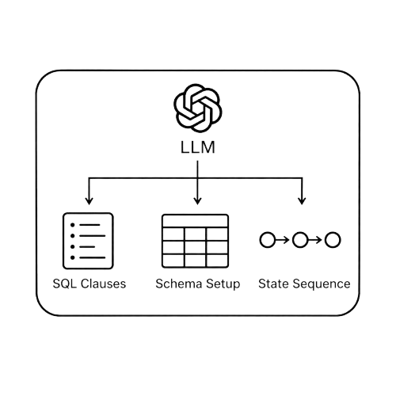





DBMS Risk Target Discovery
SQL-Reachable Seed Synthesis
Risk-Aware Directed Fuzzing
Historical Signal Mining
DBMS Risk
Pattern Synthesis
Targets & Callchains
Seed Synthesis
Fuzzer
Risk-Aware Scheduler
DBMS Source Code
LLM
Feedback
+
Function Score
Fix History
LLM
Static
Rules
Clauses
State Sequence
Schema
Callchain Score
Risk Detection Rules
Risky Targets Metadata
Fix Commits
SQL Clause/State Score
Bugs
Coverage Gap
Risky DBMS Code Regions
Target-Reaching
Seeds
Execute
Test
Seed Queue
Function Callchains
Official Tests Case
...
SQL Reachability

Slide 45


Risk Region Discovery
Context-Guided Seed Synthesis
Risk-Aware Directed Fuzzing
Historical Signal Mining
DBMS Risk
Pattern Synthesis
Targets & Callchains
Seed Synthesis
Fuzzer
Risk-Aware Scheduler
DBMS Source Code
LLM
queue
actions
+
Queue Scheduling
Seed Queue
Fix History
LLM
Static
Rules
...
Clauses
State Sequence
Schema
...
Risk Detection Rules
Risk-Target Metadata
Fix Commits
Function Score
Bugs
Coverage Gap
Risk Regions
Execute
Test
Target-Reaching
Seeds
Callchain Score
DBMS
execution
feedback
Function Callchains
Official Test Cases
SQL Clause/State Score
SQL Reachability

Slide 46


DBMS Risk Target Discovery
SQL-Reachable Seed Synthesis
Risk-Aware Directed Fuzzing
Historical Signal Mining
DBMS Risk
Pattern Synthesis
Targets & Callchains
Seed Synthesis
Fuzzer
Risk-Aware Scheduler
DBMS Source Code
LLM
queue
actions
+
Queue Scheduling
Seed Queue
Fix History
LLM
Static
Rules
...
Clauses
State Sequence
Schema
...
Risky-Targets Metadata
Risk Detection Rules
Function Score
Fix Commits
Bugs
Coverage Gap
Risky DBMS Code Regions
Execute
Test
Target-Reaching
Seeds
Callchain Score
DBMS
execution
feedback
Function Callchains
Official Tests Case
SQL Clause/State Score
SQL Reachability

Slide 47
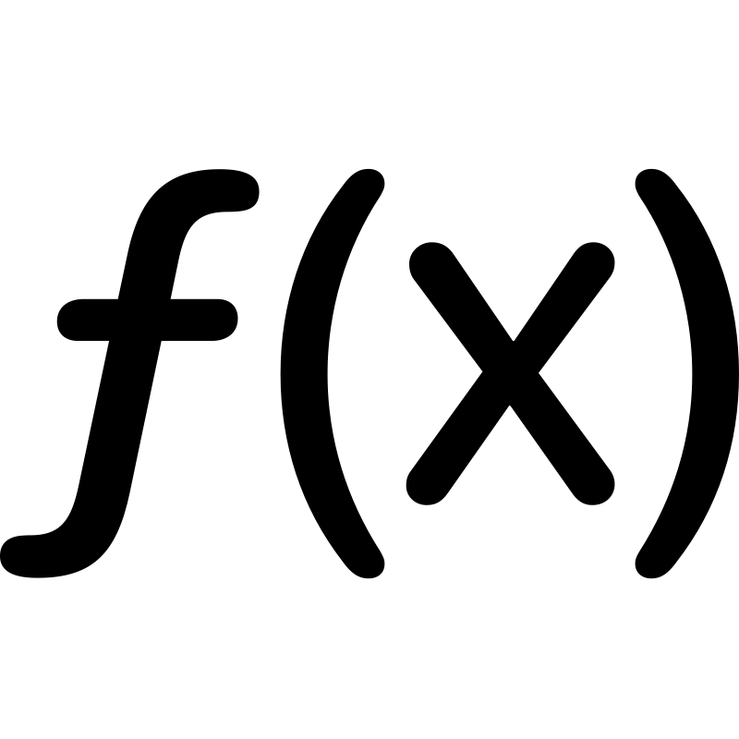


Risk Region Discovery
Context-Guided Seed Synthesis
Risk-Aware Directed Fuzzing
Commit
Refinement
DBMS Risk
Rule Synthesis
Execution Context
Stateful SQL Seed Synthesis
Fuzzer
Risk-Aware Scheduler
DBMS Source Code
queue
actions
LLM
Queue Scheduling
Risk-Function Context
Seed Queue
Fix History
LLM
Risk Rules
...
...
Clauses
State Transitions
Schema
Fix Commits
Risk Rules
Risk-Region Proximity
Bugs
Coverage Gap
Regions & Callchain Extr.
Hotspot
Context
Execute
Test
SQL Seeds
SQL-Clause Proximity
DBMS
execution
feedback
Official Test Cases
Function Callchains
State-Transition Progress
SQL Reachability
Risk
Regoins
Function Callchains

Slide 48


Risk Region Discovery
Context-Guided Seed Synthesis
Risk-Aware Directed Fuzzing
Commit
Refinement
DBMS Risk
Rule Synthesis
Execution Context
Stateful SQL Seed Synthesis
Fuzzer
Risk-Aware Scheduler
DBMS Source Code
queue
actions
LLM
Queue Scheduling
Risk-Function Context
Seed Queue
refined commit
LLM
Risk Rules
...
...
Clauses
State Transitions
Schema
Fix Commits
Risk Rules
Risk-Region Proximity
Bugs
Regions & Callchain Extr.
Hotspot
Context
Execute
Test
SQL Seeds
SQL-Clause Proximity
Coverage Gap
Source Code
Risk Regions
DBMS
execution
feedback
Official Test Cases
Function Callchains
Function Callchains
State-Transition Progress
SQL Reachability
Risk Rules

Slide 49





Historical Signal Mining
DBMS Risk Pattern Synthesis
Risky DBMS Code Regions
Inputs
Risk Evidence Extraction
LLM-Assisted
Risky-Targets Metadata
Rule Induction
Build Function Index
1.
execExprInterp()
DBMS Source
Fix History
2.
lookup_rowtype_tupdesc()
Code
derived from Fix Commits
Static Rule Templates
Map Evidence to Functions
3.
typecast_*()
Coverage Gaps
Patch-Diff Validation
Compute Priority Score
risk score
rule family
Fix Commits
from Tests + Source Code
coverage gap
source span
SQL Reachability
DBMS Risk Rule
$$p_{f}=sig_{f}·(1−cov_{f})$$
Official Test
from call graph analysis
Type /
Catalog
Cases
Row Logic
Metadata
Function
$p_{f}$ Score
Evidence
Function Callchains
xxxx.c:3656
xxxx.c:329
ExecEval*
0.92
fix+gap
SQL entry → parser → executor → execExprInterp()
type conversion
tuple descriptor
Executor
Cursor
lookup_rowtype*
0.87
family+bug
State
Paths
typecast_*
0.81
gap

Slide 50
Historical Signal Mining
DBMS Risk Pattern Synthesis
Fix History
Risk Pattern Synthesis
derived from Fix Commits
Patch-Diff Validation
Coverage Gaps
Target Mining & Ranking
from Tests + Source Code
SQL Reachability
Risk-Target Metadata
from call graph analysis
Function Callchains

Slide 51
Historical Signal Mining
Targets & Callchains
Fix History
derived from Fix Commits
Risk-Target Metadata
Coverage Gaps
target function
from Tests + Source Code
execExprInterp()
risk score / family
SQL Reachability
coverage gap / span
from call graph analysis
DBMS Risk Pattern Synthesis
Function Callchains
Risk Pattern Synthesis
SQL entry
parser
Patch-Diff Validation
executor
target f
Target Mining & Ranking

Slide 52

Historical Signal Mining
Targets & Callchains
Fix History
Coverage Gaps
SQL Reachability
Risk-Target Metadata
derived from
Fix Commits
from Tests and Source Code
from call graph analysis
target function
execExprInterp()
risk score / family
Risk Pattern
coverage gap / span
DBMS Risk Rule Synthesis
Function Callchains
LLM-Assisted
Risk Regions
Rule Induction
SQL entry
Risk Pattern
Risk Rule
parser
executor
Patch-Diff Validation
target f
DBMS Source Code

Slide 53






Commit Refinement
Target & Callchain Extraction
Risk-Target Metadata
Function Callchains
Commit History
Target Function
Code Span
Matched Risk Rule
Parser →
Executor →
… → Target
Messages
Code changes
Commit Filter
Refinement
Commit
Commit Context
Patch Diff
Rule
Coverage Gaps
SQL Reachability
from Tests Case
call graph analysis
Source Code
Risk Rules
Risk Regions
Refinement Commit
Risk Rules
DBMS Risk Rule Synthesis
commit context
Rule
validation
Rule
Refinement Commit
LLM
Candidate
Risk Rules
Patch-Diff
Validation
Risk Rules
feedback

Slide 54


Commit Refinement
Regions & Callchain Extraction
Refinement
Commit
Commit History
Commit Filter
Risk Regions
Function Callchains
Coverage Gaps
SQL Reachability
Source Code
Risk Rule
Refinement Commit
Risk Rules
DBMS Risk Rule Synthesis
commit context
validation
Refinement
Commit
LLM
Candidate
Risk Rules
Patch-Diff
Validation
Risk Rules
feedback

Slide 55
Commit Refinement
Regions & Callchain Extraction
Commit History
Coverage Gaps
Source Code
Risk Regions
SQL
Reachability
Function
Callchains
Commit Filter
Risk Rule
Refinement
Commit
Risk Rules
DBMS Risk Rule Synthesis
commit context
validation
Refinement
Commit
LLM
Candidate
Risk Rules
Patch-Diff
Validation
feedback

Slide 56
Refined Fix Commit
Synthesized Risk Rule
Commit Message
1
LLM
Synthesis
2
Candidate
Risk Rule
heap tuple deconstruction
data using inconsistent offsets
...
Patch Diff
Validated
Risk Rule
Patch-Diff
Validation
3
--- .../access/heap/heapam.c
+++ .../access/heap/heapam.c
@@ -1333,6 +1333,11 @@
Risk Rule
- datum = fetchatt(hdr, &isnull);
import DataFlow
- /* missing validation */
import ControlFlow
+ if (attnum >= natts || attnum)
rule RiskyFieldAccess {
+ elog(ERROR, "invalid attribute");
match (Access a, Index i,
Object o)
+ datum = fetchatt(hdr, &isnull);
...
where
Source Context
dataDependent(i, a)
1330 Datum heap_getattr(HeapTuple)
and sameObject(a, o)
1331 ...
and not validated(i)
1332 if (attnum > 0)
and reachesRiskOperation(a)
1333 return fetchatt(...);
select a
1334 ...
}

Slide 57


Targets & Callchains
Seed Synthesis
Target-Reaching Seeds
Risk-Target Metadata
Context Construction
Executable SQL Seed
target function
Source Context
Clause Hints
Target Metadata
1 CREATE TYPE ...
execExprInterp()
SQL
2 CREATE TABLE ...
risk score / family
3 PREPARE p AS ...
coverage gap / span
4 ALTER TYPE ...
LLM-Assisted Inference
5 EXECUTE p
reaches target function
Function Callchains
Clauses
State Transitions
Schema
SQL entry
parser
LLM infers a seed specification from code context
Seed Metadata
executor
target
clause
state
target f
Validation & Repair
id
tags
hints
To Risk-Aware Directed Fuzzing

Slide 58


Context-Guided Seed Synthesis
Target-Reaching Seeds
Context Construction
Executable SQL Seed
Source Context
Clause Hints
Target Metadata
1 CREATE TYPE ...
SQL
2 CREATE TABLE ...
3 PREPARE p AS ...
4 ALTER TYPE ...
LLM-Assisted Inference
5 EXECUTE p
reaches target function
Clauses
State Transitions
Schema
Seed Metadata
target
clause
state
id
tags
hints
Validation & Repair
To Risk-Aware Directed Fuzzing

Slide 59

Context-Guided Seed Synthesis
Target-Reaching Seeds
Context Construction
Executable SQL Seed
Source Context
Clause Hints
Target Metadata
1 CREATE TYPE ...
SQL
2 CREATE TABLE ...
3 PREPARE p AS ...
4 ALTER TYPE ...
LLM-Assisted Inference
5 EXECUTE p
reaches target function
Clauses
State Transitions
Schema
Seed Metadata
target
clause
state
id
tags
hints
Validation & Repair
To Risk-Aware Directed Fuzzing

Slide 60

Execution Context Construction
Stateful SQL Seed Synthesis
Context Construction
Execution
Context
Validation & Repair
Feedback
Execute
Execution Context
Risk-Function
Context
SQL
SQL
LLM-Assisted
Inference
Candidate
SQL Seeds
Risk
Regions
SQL Seeds
Template Expansion
Hotspot Context
SQL Template
Function
Callchains
Call chain
Clauses
State Transitions
Schema

Slide 61

Execution Context Construction
Stateful SQL Seed Synthesis
Executable SQL Seed
Risk Target
SQL-Reachable
Call chains
Source Snippets
1 CREATE TYPE ...
SQL
2 CREATE TABLE ...
3 PREPARE p AS ...
4 ALTER TYPE ...
5 EXECUTE p
reaches target function
Evidence-Oriented LLM Inference
Schema &
Object Constraint
Seed Metadata
SQL Clauses
State Transitions
target
clause
state
id
tags
hints
To Risk-Aware Directed Fuzzing
Validation & Repair

Slide 62
Execution Context Construction
Seed Synthesis
Target-Reaching Seeds
Context Construction
Executable SQL Seed
Source Context
Clause Hints
Target Metadata
1 CREATE TYPE ...
Risk-Target Metadata
Function Callchains
SQL
2 CREATE TABLE ...
3 PREPARE p AS ...
4 ALTER TYPE ...
LLM-Assisted Inference
5 EXECUTE p
reaches target function
Execution Context
Clauses
State Sequence
Schema
LLM infers a seed specification from code context
Seed Metadata
target
clause
state
Validation & Repair
id
tags
hints
To Risk-Aware Directed Fuzzing

Slide 63
Fuzzer
Risk-Aware Scheduler
Seed Queue
queue
actions
Queue Scheduling
...
Amplify
Keep
Defer
4
updates seed queue and mutation budget
1
3
score update
Risk-Aware Score
Execute
SQL
Test
Function Score
Bugs
Callchain Score
Runtime Feedback
execution
feedback
coverage bitmap
SQL Clause/State
crash signal
Score
clause/state trace
2

Slide 64
Fuzzer
Risk-Aware Scheduler
Seed Queue
queue
actions
Queue Scheduling
...
Amplify
Keep
Defer
4
1
3
score update
Execute
Risk-Aware Score
SQL
Test
Bugs
Function Score
execution
feedback
Runtime Feedback
Callchain Score
coverage bitmap
2
crash signal
SQL Clause
clause/state trace

Slide 65
Fuzzer
Risk-Aware Scheduler
Seed Queue
queue
actions
Queue Scheduling
...
Amplify
Keep
Defer
4
1
3
score update
Execute
Risk-Aware Score
SQL
Test
Bugs
Risk-Region Proximity
execution
feedback
Runtime Feedback
SQL-Clause Proximity
coverage bitmap
2
crash signal
State-Transition Progress
clause/state trace

Slide 66
Correct Trigger Path
ALTER TYPE foo
ALTER ATTRIBUTE a
TYPE VARCHAR(100)
PREPARE p AS
SELECT CAST(ROW(1,'hello') AS foo)::text
CREATE TYPE foo
→
→
EXECUTE p
→
→
EXECUTE p
→
Crash
Motivating Example: PostgreSQL Bug #19470
Coverage-Guided Fuzzing Path
×
Failure: Executable but Testing-Ineffective → No Crash
Step1: Fragment-Level Mutation
Step2: Local Coverage Retention
CREATE TYPE / PREPARE / ALTER TYPE / EXECUTE
parser / catalog / type system / executor coverage↑ missing PREPARE → EXECUTE → ALTER TYPE → EXECUTE order
×
Coverage-Only Selection
×
No State-Sequence Awareness
SQLeek Risk-Driven Path
✓
Crash Triggered
Step1: Risk Target Identification
Step2: Call-Chain-Guided Inference
Step3: Stateful Seed Synthesis
heap_deform_tuple / record_out /
ExecInterpExprStillValid
metadata mutation + re-execution + composite output
CREATE TYPE → PREPARE → EXECUTE → ALTER TYPE → EXECUTE
✓
High-Risk Targets
✓
State Condition Recovered
✓
Trigger Sequence Preserved

Slide 67
Correct Trigger Path
ALTER TYPE foo
ALTER ATTRIBUTE a
TYPE VARCHAR(100)
PREPARE p AS
SELECT CAST(ROW(1,'hello') AS foo)::text
CREATE TYPE foo
→
→
EXECUTE p
→
→
EXECUTE p
→
Crash
Motivating Example: PostgreSQL Bug #19470
Coverage-Guided Fuzzing Path
×
Failure: Executable but Testing-Ineffective → No Crash
Step1: Fragment-Level Mutation
Step2: Local Coverage Retention
CREATE TYPE / PREPARE / ALTER TYPE / EXECUTE
parser / catalog / type system / executor coverage↑ missing PREPARE → EXECUTE → ALTER TYPE → EXECUTE order
×
Coverage-Only Selection
×
No State-Sequence Awareness
SQLeek Risk-Driven Path
✓
Crash Triggered
Step1: Risk Target Identification
Step2: Call-Chain-Guided Inference
Step3: Stateful Seed Synthesis
heap_deform_tuple / record_out /
ExecInterpExprStillValid
metadata mutation + re-execution + composite output
CREATE TYPE → PREPARE → EXECUTE → ALTER TYPE → EXECUTE
✓
High-Risk Targets
✓
State Condition Recovered
✓
Trigger Sequence Preserved

Slide 68
Correct Trigger Path:
ALTER TYPE foo
ALTER ATTRIBUTE a
TYPE VARCHAR(100)
PREPARE p AS
SELECT CAST(ROW(1,'hello') AS foo)::text
CREATE TYPE foo
→
→
EXECUTE p
→
→
EXECUTE p
→
Crash
Motivating Example: PostgreSQL Bug #19470
Coverage-Guided Fuzzing Failure
×
Executable but Testing-Ineffective → No Crash
Step1: Fragment-Level Mutation
Step2: Local Coverage Retention
CREATE TYPE / PREPARE / ALTER TYPE / EXECUTE
parser / catalog / type system / executor coverage↑ missing PREPARE → EXECUTE → ALTER TYPE → EXECUTE order
×
Coverage-Only Selection
×
No State-Sequence Awareness
SQLeek Risk-Driven Path
✓
Crash Triggered
Step1: Risk Target Identification
Step2: Call-Chain-Guided Inference
Step3: Stateful Seed Synthesis
heap_deform_tuple / record_out /
ExecInterpExprStillValid
metadata mutation + re-execution + composite output
CREATE TYPE → PREPARE → EXECUTE → ALTER TYPE → EXECUTE
✓
High-Risk Targets
✓
State Condition Recovered
✓
Trigger Sequence Preserved

Slide 69
Trigger Path:
SELECT * FROM t0 WHERE AGE(t0.c1, NOW()) > '1 year'::INTERVAL;
Step1: LLM Translation
Step2: Unparsable Commenting
WHERE AGE(t0.c1, ...) > ...
WHERE /*AGE...*/ TRUE
Hallucinations
Logic Loss
Step1: Query Abstraction (AQT)
Step2: Instantiation (DuckDB)
WHERE <TimeDiff> > <Interval>
WHERE date_diff('year') > INTERVAL ...;
Translate Success
Logic Preserved

Slide 70



DBMS Risk Target Discovery
SQL-Reachable Seed Synthesis
Risk-Aware Directed Fuzzing
Historical Signal Mining
DBMS Risk
Pattern Synthesis
Targets & Callchains
Seed Synthesis
Fuzzer
Risk-Aware Scheduler
DBMS Source Code
LLM
Feedback
+
Function Score
Fix History
LLM
Static Rules
Clauses
State Sequence
Schema
Callchain Score
Risky Targets Metadata
Risk Detection Rules
Fix Commits
SQL Clause/State Score
Bugs
Coverage Gap
Risky DBMS Code Regions
Target-Reaching
Seeds
Execute
Test
Seed Queue
Function Callchains
Official Tests Case
...
SQL Reachability

Slide 71
Materials

